Slide 1




NEXT GEN EMPLOYABILITY PROGRAM
Creating a future-ready workforce
Team Members
College Name
Student Name :Bharathi J
Student ID :au613021104013
Vivekanandha college of Technology for Women

Slide 2

CAPSTONE PROJECT SHOWCASE
Project Title
Notes Sharing Web Application using Django Framework
Abstract | Problem Statement | Project Overview | Proposed Solution | Technology Used | Modelling & Results | Conclusion

Slide 3
Abstract Online note sharing is the project used for sharing notes using website. Notes that the user wants for the particular subject can be found in the website. This project is written in php and mysql. The user need to sign up and then, they can log into system. They will get their own dashboard where they can see the number of notes for the particular faculty. After that they can download it and read the notes. They can even upload the notes if they have some. They can even edit the profile like name, profile, change password. Eventually, in admin side they can see all the users who are using it. Admin has the authority to delete the users too. If the user had uploaded the notes then admin check the note and is it is usable then they will approved it and all the other user will get the note according to the faculty.
Source :

Slide 4
Problem Statement Efficient Note Creation Centralized Note Storage Collaborative Note Sharing Customizable Organization Version Control and History Cross-Platform Accessibility Security and Privacy
Source :

Slide 5
Project Overview The Note Sharing Web Application is a platform designed to facilitate the creation, storage, sharing, and management of notes for individuals and teams. It provides users with a centralized repository to store their notes securely, accessible from any device with an internet connection. The application aims to streamline the note-taking process, enhance collaboration, and improve productivity for users across various domains.
Source :

Slide 6
Proposed Solution The proposed Notes Sharing Web Application offers a comprehensive solution for individuals and teams to create, store, share, and manage notes effectively. By combining powerful features such as user authentication, note creation, sharing, version control, and search capabilities with robust security and privacy measures, the application aims to enhance productivity, collaboration, and organization for users across various domains.
.
Source :

Slide 7
Key Features
User Registration and Authentication
Note Creation and Management
Collaborative Note Sharing
Version Control and Revision History
Search and Filtering
Cross-Platform Accessibility
Source :

Slide 8


Technology Used
Front-end
Back-end
Source :

Slide 9
Modelling & Results Fields: username, email, password, date_joined, last_login Relationships: One-to-many with Note model Users can register for an account with a username, email, and password. Authentication system ensures secure access to the application's features. Notes are stored securely in the database and associated with the user who created them. Users can update, delete, and organize notes into folders. Sharing options include granting view-only or edit access to shared notes. Collaborators can leave comments or suggestions on shared notes.
Source :

Slide 10
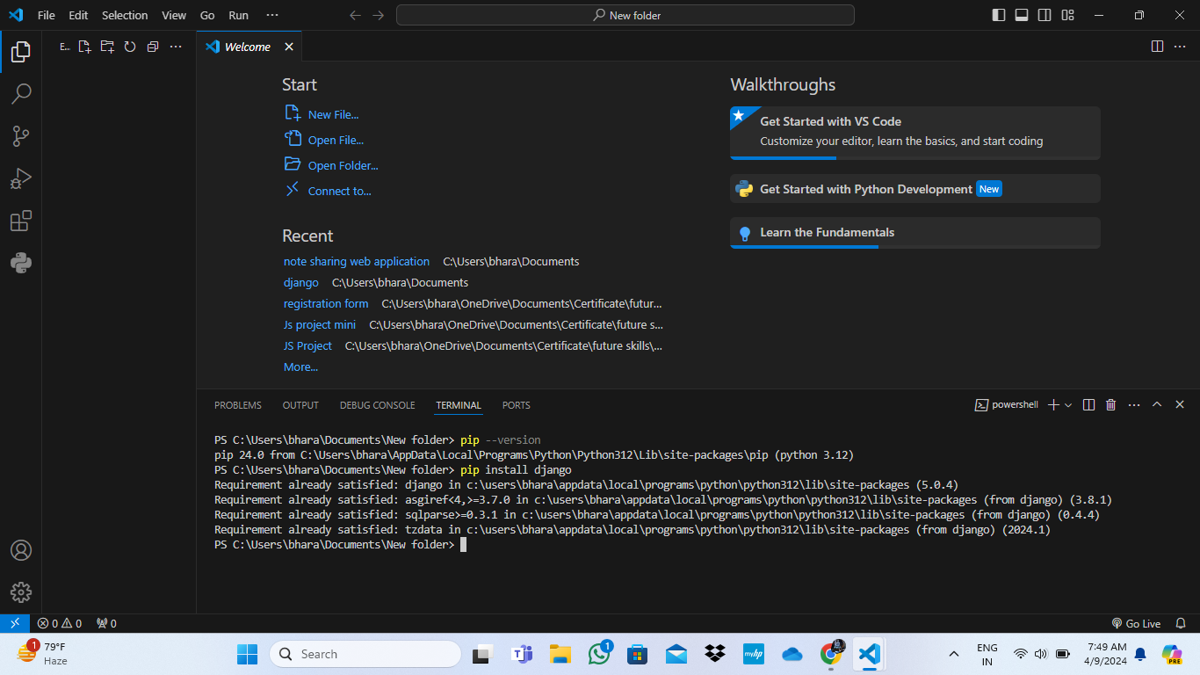
Homepage

Slide 11
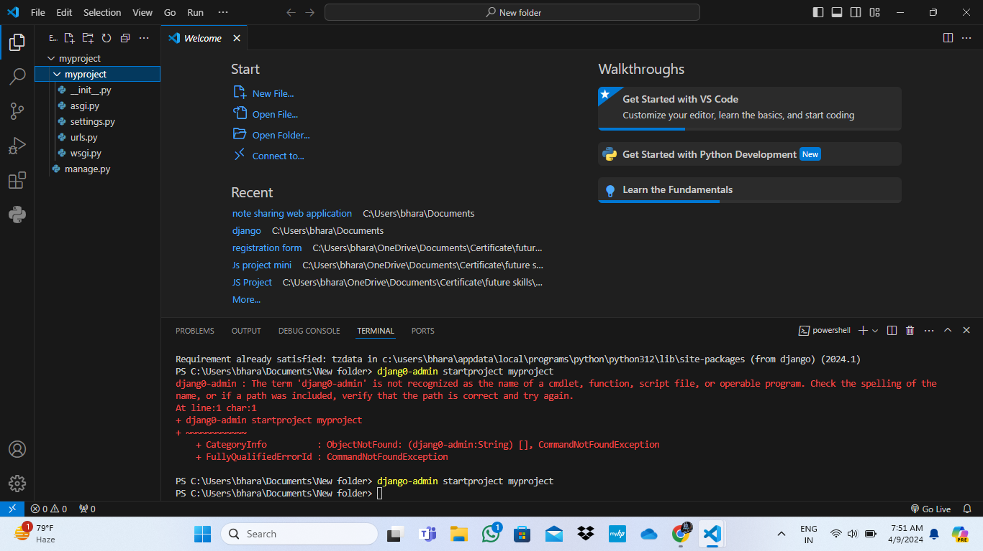
About-Us-Page

Slide 12
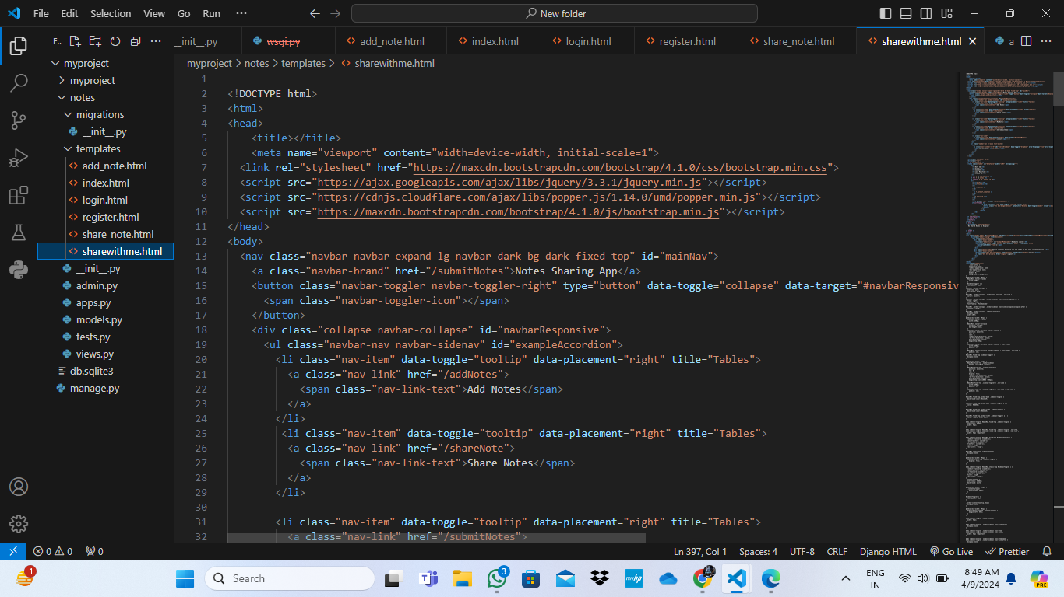
Service-Page

Slide 13
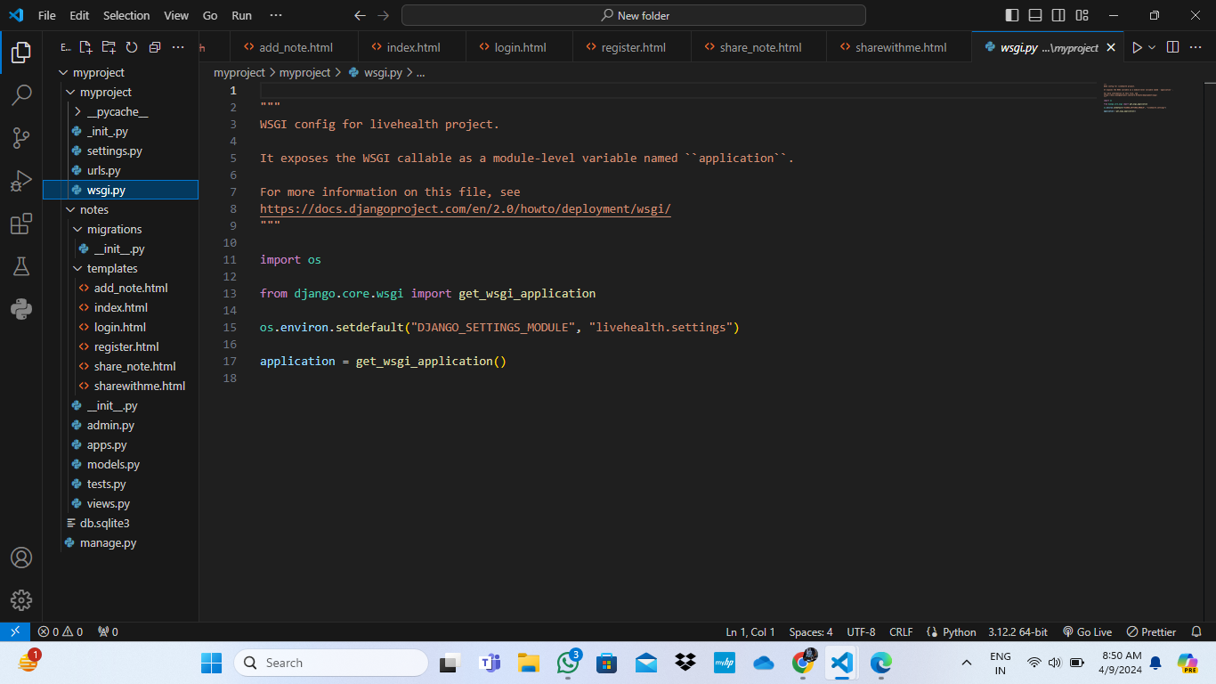
Departments-Page

Slide 14
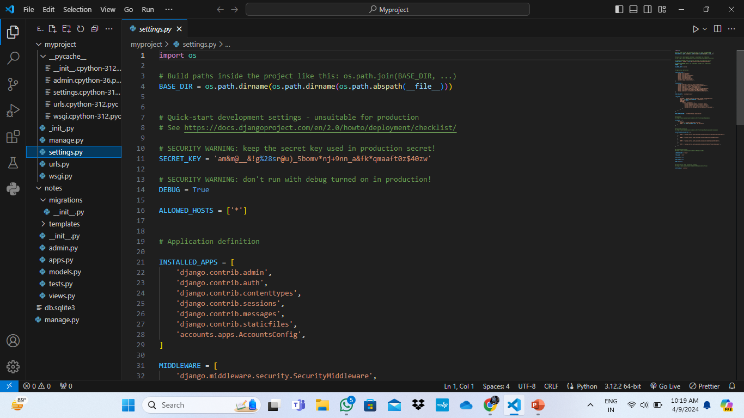
Blog-Page

Slide 15
Future Enhancements: Real-Time Collaboration: Implement real-time collaboration features, allowing multiple users to edit a note simultaneously and see changes in real-time, similar to Google Docs. Rich Media Support: Enhance note-taking capabilities by supporting the embedding of images, videos, audio files, and other rich media content within notes. Integration with External Services: Integrate the application with external services such as Google Drive, Dropbox, or Evernote, allowing users to import/export notes seamlessly. Notifications and Alerts: Implement notification features to alert users about new shared notes, comments on their notes, or upcoming deadlines associated with notes.

Slide 16
Conclusion In conclusion, the Note Sharing Web Application presents a robust solution for individuals and teams seeking to streamline their note-taking processes, enhance collaboration, and improve productivity. Through its user-friendly interface and comprehensive feature set, the application addresses key challenges associated with managing notes across different platforms and devices. By providing users with centralized access to their notes, the application promotes organization and efficiency. Users can easily create, store, and manage notes, categorizing them into folders or tags for better organization. The ability to share notes with others fosters collaboration and teamwork, allowing users to work together on projects, tasks, and study materials.
Source :

Slide 17
Thank You!
Notes:
Thank You !!

